Slide 1


DATA221 Intro Machine Learning 09 K-nearest-neighbor classifier The curse of dimensionality
William Trimble
Spring 2023

Slide 2
Testing / validation / training
More parameters always gives better fit.
”Fits always look good”!!! (Fits are biased toward the data and away from the truth !!)
Semantically:
Model selection: find the best model among a handful of alternatives
Model evaluation: estimate the error rate that the model will have on out-of-training-sample data
The need for avoiding bias in model evaluation here gives rise to the
Training / Validation / Test set convention:
The validation set you can peek at the answers to tune hyperparameters (regularization strength, k)
Can’t use cross-validation both for hyperparameter tuning and evaluation.

Slide 3
3 similar techniques…
knn classification
knn regression
knn clustering (of which k-means is one algorithm)

Slide 4
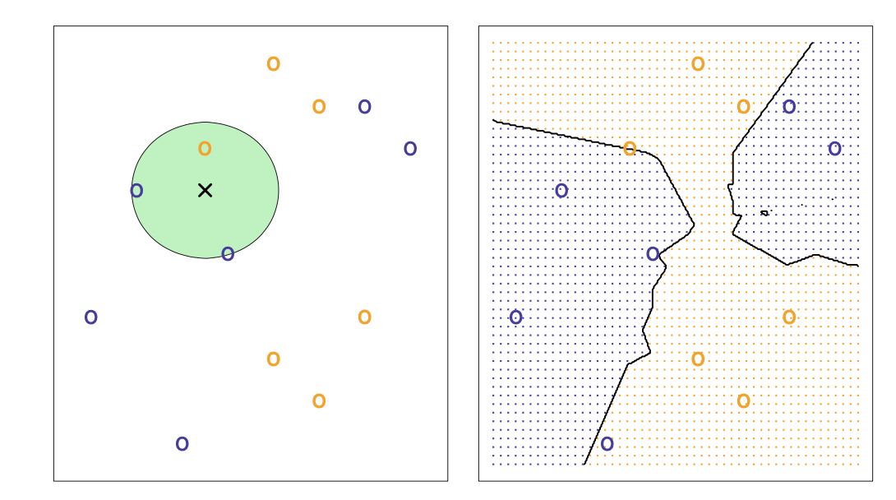
KNN classification : what do you need to be able to do to pull this off?

Slide 5
KNN classification : What does the green circle mean?

Slide 6
Features and labels as matrices…
r features
n labels
X
Y
n examples
n examples / individuals / observations
n x r
n x 1
This is the form a lot of our library functions will expect.

Slide 7
Features and labels as matrices…
r features
n labels
X
w
=
Y
n examples
n examples / individuals / observations
n x r
r x 1
n x 1

Slide 8
Features and labels as matrices…
r features
X
Y
n examples
n examples / individuals / observations
n x r
n x 1
new X
1 x r

Slide 9
Distance matrices
X
Generalization of L2-norm
(X^{T}X = Σ x_{i}² )
that allows different components of x different weights.
X^{T}
= |X|²
r features
X
D
X^{T}
= |X|_{D}²
1 example
1 x r
r x r
r x 1
1 x 1

Slide 10
Distance matrices
If the distance metric matrix is diagonal, this is just a weighted sum:
X D X^{T} = Σ x_{i}²𝜎_{i}⁻²
r features
X
𝜎₁⁻²
D
X^{T}
𝜎₂⁻²
1 example
𝜎₃⁻²
1 x r
r x r
r x 1

Slide 11
KNN
Always put attention on the distance metric.
Gets more accurate with increasing n (at constant n/N) but becomes very slow.
Tends not to work well in high numbers of dimensions. Why? Density of training points in high-dimensional space is low; will tend not to have examples that are alike enough.
Prototypical high-dimensional space is bag-of-words. 2,000-5,000 parameters for starters. (Spam classifier)
We didn’t have to fit those, though! We used empirical means (easy to calculate, didn’t have to run optimizer) that were maximum-likelihood estimates of the parameters. Not all problems are so easy.

Slide 12
“The flaw of averages”
In the late 1940s, pilots were crashing planes at rates that were concerning to the US Air Force.
Aviation cockpits were based on measurements from 1926.. was it possible that pilots 20 years later were bigger?
Gilbert Daniels measures 4063 pilots in 10 aviation-relevant sartorial dimensions. Roughly normal distribution on each one, right?
The End of Average Todd Rose
https://www.thestar.com/news/insight/2016/01/16/when-us-air-force-discovered-the-flaw-of-averages.html

Slide 13
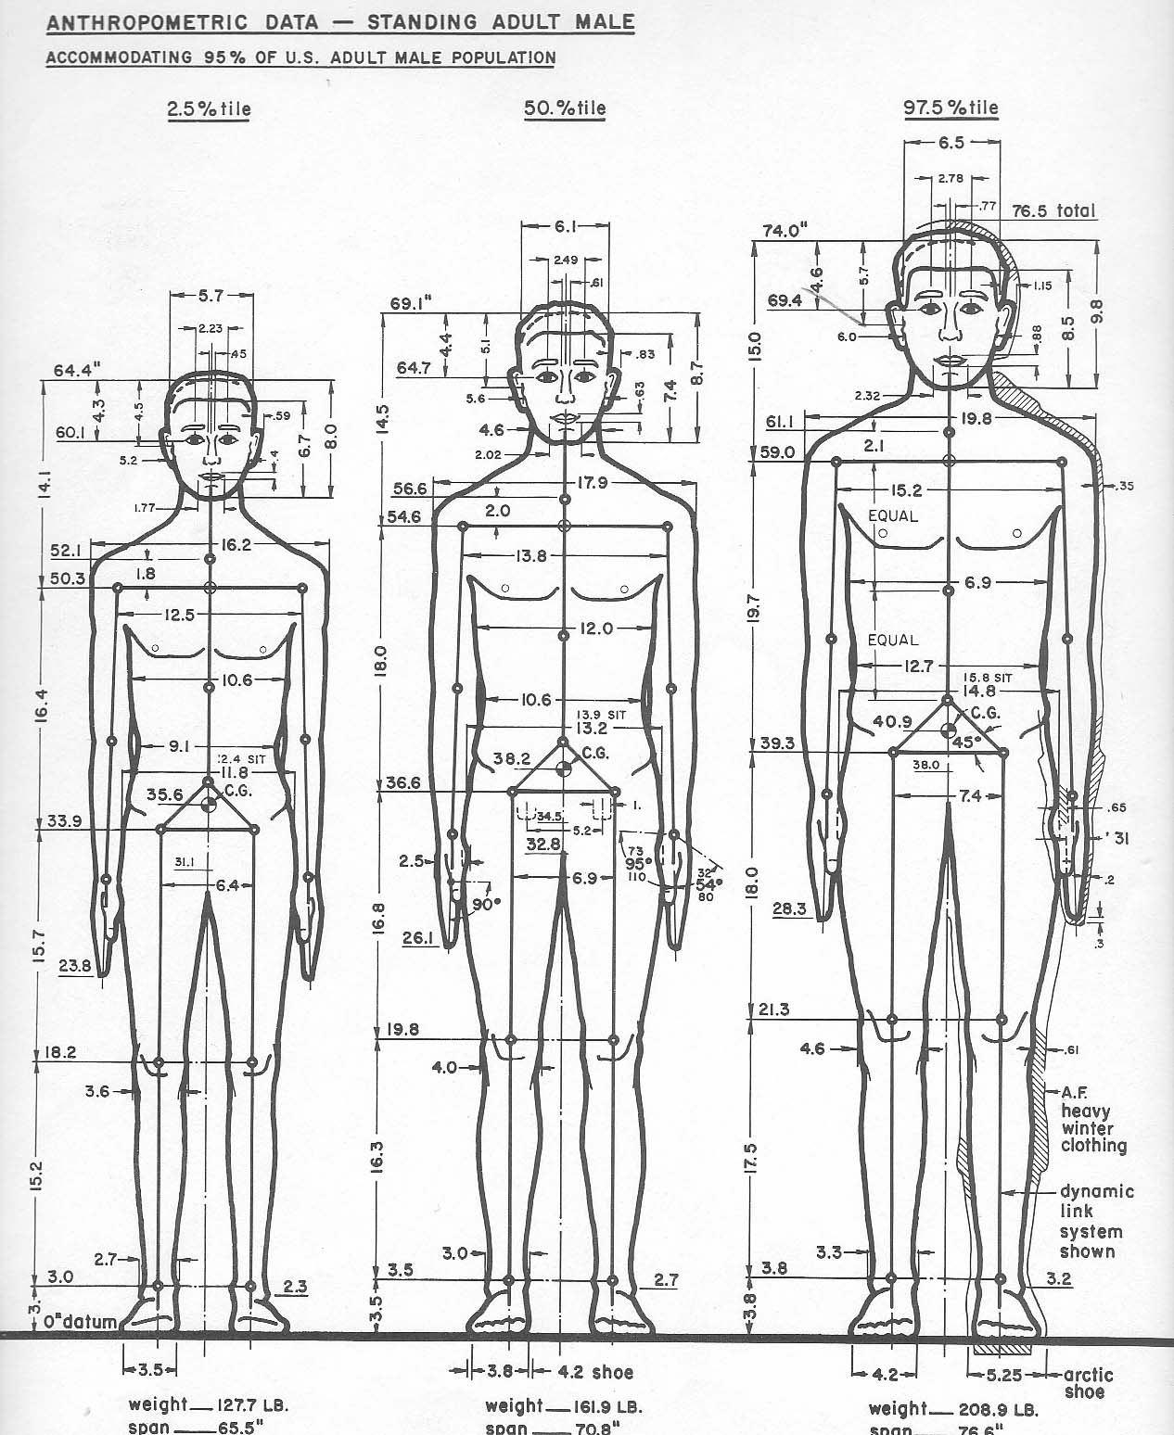
How many pilots really were average?
Given a set of measurements (relevant for clothing design or cockpit design), there is a distribution of measurements in each dimension.
How many pilots are close to the average in all dimensions?
Gilbert Daniels, ‘The “Average Man”?’ Air force technical report
https://apps.dtic.mil/sti/citations/AD0010203

Slide 14
How many pilots really were average?
Take plus or minus 0.3 standard deviations in each dimension to be “approximately average” – this is about the middle third.
Of the original 4063 men, 1055 were of approximately average stature.
of these 1055 men, 302 were also of approximately average chest circumference.
of these 302 men, 143 were also of approximately average sleeve length.
of thsee 143 men, 73 were also of approximately average crotch height.
of these 73 men, 28 were also of approximately averages torso circumference
of these 28 men, 12 were also of approximately average hip circumferences.
of these 12 men, 6 were also of approximately average neck circumference.
of thsee 6 men, 3 were also of approximately average waist circumference.
of these 3 men, 2 were also of approximately average thigh circumference.
of these 2 men, 0 were approximately average in crotch length.
Huh. Requiring close-to-average on many dimensions becomes an impossible selection problem.
Gilbert Daniels, ‘The “Average Man”?’ Air force technical report
https://apps.dtic.mil/sti/citations/AD0010203

Slide 15
How many pilots really were average?
“Out of 4,063 pilots, not a single airman fit within the average range on all 10 dimensions. One pilot might have a longer-than-average arm length, but a shorter-than-average leg length. Another pilot might have a big chest but small hips. Even more astonishing, Daniels discovered that if you picked out just three of the ten dimensions of size — say, neck circumference, thigh circumference and wrist circumference — less than 3.5 per cent of pilots would be average sized on all three dimensions. Daniels’s findings were clear and incontrovertible. There was no such thing as an average pilot. If you’ve designed a cockpit to fit the average pilot, you’ve actually designed it to fit no one.”
Todd Rose The End of Average (2016)
https://www.thestar.com/news/insight/2016/01/16/when-us-air-force-discovered-the-flaw-of-averages.html

Slide 16
How many pilots really were average?
The historians tell us that after 1952, the military demanded that aviation contractors make the aircraft fit the pilots rather than selecting the pilots that fit well in the aircraft.
…but still only 9% of women in the Air Force in 2020 were of the right size to use the F-15 cockpit.
https://www.airforcetimes.com/news/your-air-force/2020/08/19/to-get-more-female-pilots-the-air-force-is-changing-the-way-it-designs-weapons/

Slide 17
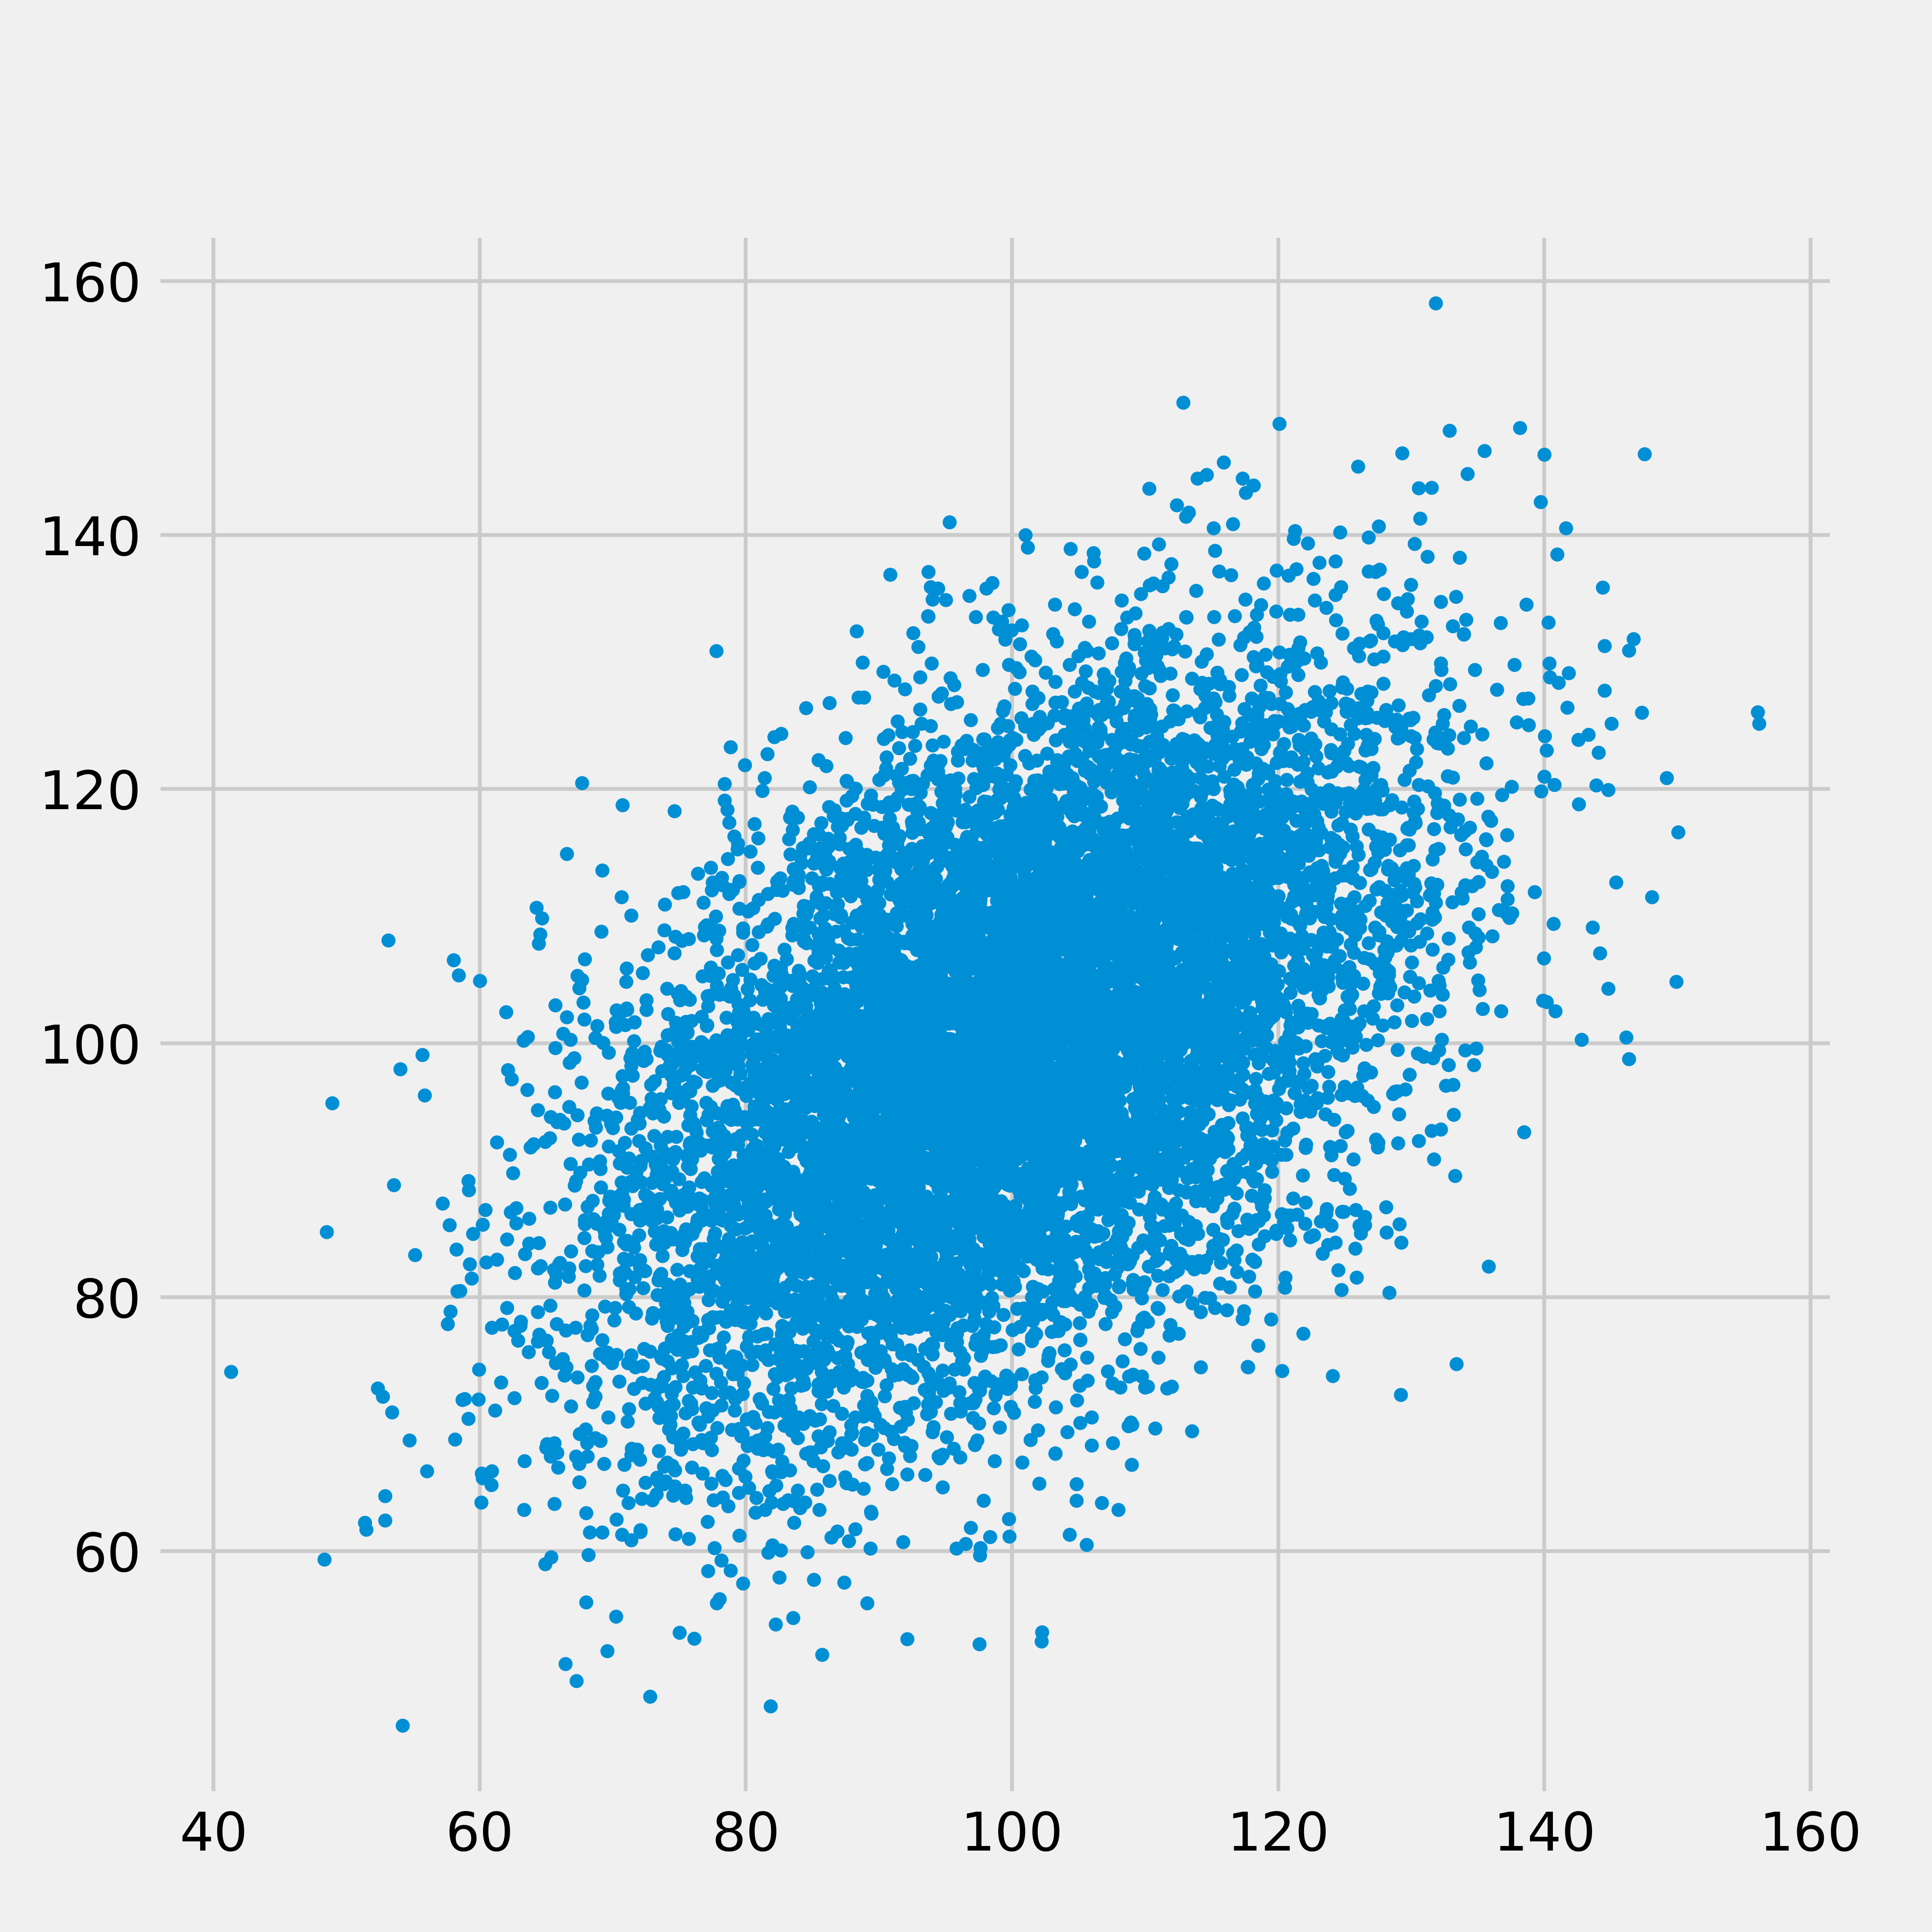
If you ever wonder why your
clothes don’t fit,
blame the curse of dimensionality.
XL
L
M
S

Slide 18
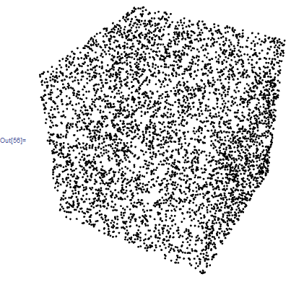
Curse of dimensionality
Things don’t work in high numbers of dimensions the way we expect them to.
Computing n 1st derivative components and keeping track of n(n+1) 2nd derivative components is not the worst of our troubles.
Data become sparse in vast high-dimensional spaces (where machine learning parameters live)
Limited data .. all linear combinations of N data points in ℝ^{D} allow only vectors in an ℝ^{N} subspace
In high dimensions it’s clear you don’t have the data to do combinatorical tests. When 2^{D} >> N situation is hopeless and there are always dimensions you never sample from.

Slide 19
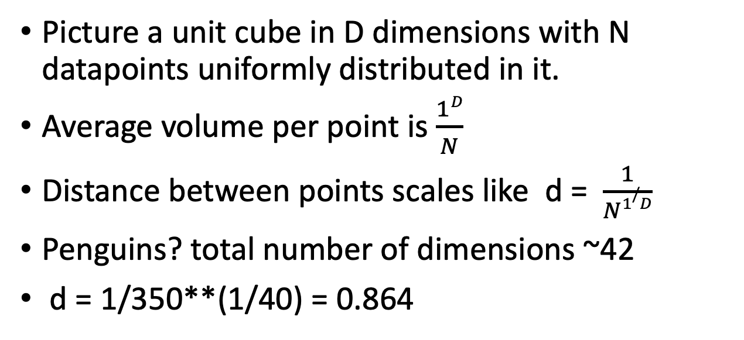
Curse of dimensionality…
Picture a unit cube in D dimensions with N datapoints uniformly distributed in it.
Average volume per point is $\frac{1D}{N}$
Distance between points scales like d = $\frac{1}{N1/D}$
Penguins? total number of dimensions ~42
d = 1/350**(1/40) = 0.864
To get just 1/350 of the data, I need a cube 0.864 on a side? This is a huge fraction of the span of each dimension.
It will take a very large radius just to capture on average a handful of datapoints, and my nearest datapoints may not be very similar.

Slide 20
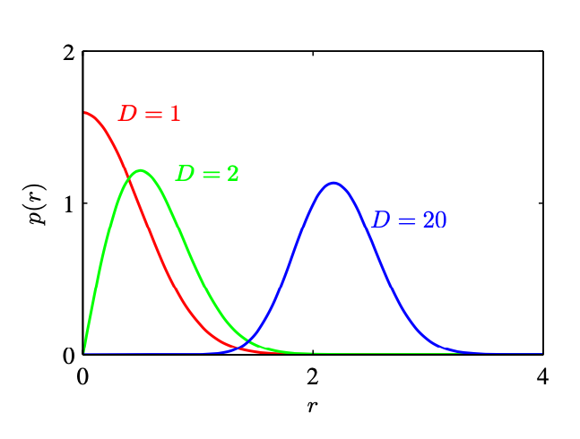
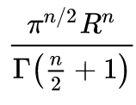
Multivariate normal, how bad can it be?
The volume of a sphere in N dimensions is
Surface area is proportional to R^{n-1}
MVN density centered at 0 in D dimensions, but the vast majority of the probability density is in a shell at the surface where the terms in x^{D}exp(-x²) balance.

Slide 21
Large-dimensional optimization
The Linear discriminant and naïve Bayesian attacks didn’t require optimization; we could use summary statistics to get the parameters of models with 20,000 words without fitting. When we are lucky…
Optimizing in vast numbers of dimensions… we don’t find the same answer every time.
ChatGPT didn’t use summary statistics to fit 1.3 billion parameters.. it used stochastic gradient descent optimization.

Slide 22
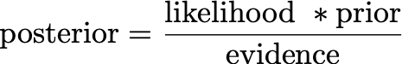
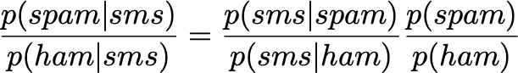
And the evidence, which is p(sms) which is p(sms|smam)p(spam) + p(sms|ham)p(ham)
appears in both the numerator and the denominator so we don’t need to calculate it.

Slide 23
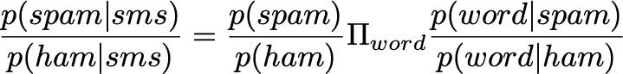

Slide 24


Slide 25


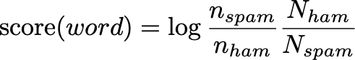
This is remarkably like a linear model for logodds with a per-word weight
and overall bias !!

Slide 26
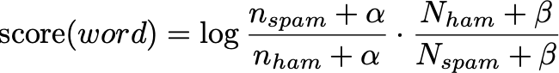
This is remarkably like a linear model for logodds with a per-word weight
and overall bias !!

Slide 27
That “prior”…. in this problem the prior is a single number (almost like an intercept term in logistic regression)
We can estimate the fraction of spam to ham, (from judgement)..
We can also adjust the prior to improve the behavior of the model. This is just a number in our model. If the balance between FP and FN is not to our liking, turn the knob.
Which do we tolerate more, FP or FN?
Depends: drone attacks on the wrong suspected terrorist?
cancer screening? Spammy-looking job adverts??

